Slide 1
For Live Session
Unit 5
Carlos estevez

Slide 2
Part 1 (2 hours)

Slide 3
BBALL STUDY
We previously used a dataset called PlayerBBall.csv which contained information about NBA basketball players. To finish that assignment, you had to manipulate the height column. Review the code you used to do that and see if you can’t make more efficient code using regular expressions and / or the string functions from this Unit.
Use regular expressions to use the height column to create a TotalInches column that has the total height in inches and is recorded as a numeric variable.
Use this variable to make a chart that contains histograms of heights for every position (color coded).

Slide 4
Part 2 (2-3 hours)

Slide 5
FIFA STUDY
We previously used a dataset called FIFA Players.csv which contained information about Soccer players.
Use the string functions and regular expressions to assess a relationship between height and weight among soccer players. To do this you will need to manipulate the height and weight columns into columns that have numeric values of the height and weight. Tell your story using 2 – 4 PPT Slides.
Next, assess this relationship between just the LB and LM positions. (1 slide should do it.)

Slide 6
Part 3 (2 – 4 hours)

Slide 7
BABY NAMES
Backstory: Your client is expecting a baby soon. However, he is not sure what to name the child. Being out of the loop, he hires you to help him figure out popular names. He provides for you raw data in order to help you make a decision.

Slide 8
Baby Names: Question 1
Data Munging (30 points): Utilize yob2016.txt for this question. This file is a series of popular children’s names born in the year 2016 in the United States. It consists of three columns with a first name, a gender, and the amount of children given that name. However, the data is raw and will need cleaning to make it tidy and usable.
First, import the .txt file into R so you can process it. Keep in mind this is not a CSV file. You might have to open the file to see what you’re dealing with. Assign the resulting data frame to an object, df, that consists of three columns with human-readable column names for each.
Display the summary and structure of df
Your client tells you that there is a problem with the raw file. One name was entered twice and misspelled. The client cannot remember which name it is; there are thousands he saw! But he did mention he accidentally put three y’s at the end of the name. Write an R command to figure out which name it is and display it.
Upon finding the misspelled name, please remove this particular observation, as the client says it’s redundant. Save the remaining dataset as an object: y2016

Slide 9
Baby Names: Question 2
2. Data Merging (30 points): Utilize yob2015.txt for this question. This file is similar to yob2016, but contains names, gender, and total children given that name for the year 2015.
Like 1a, please import the .txt file into R. Look at the file before you do. You might have to change some options to import it properly. Again, please give the dataframe human-readable column names. Assign the dataframe to y2015.
Display the last ten rows in the dataframe. Describe something you find interesting about these 10 rows.
Merge y2016 and y2015 by your Name column; assign it to final. The client only cares about names that have data for both 2016 and 2015; there should be no NA values in either of your amount of children rows after merging.

Slide 10
Baby Names: Question 3
3. Data Summary (30 points): Utilize your data frame object final for this part.
Create a new column called “Total” in final that adds the amount of children in 2015 and 2016 together. In those two years combined, how many people were given popular names?
Sort the data by Total. What are the top 10 most popular names?
The client is expecting a girl! Omit boys and give the top 10 most popular girl’s names.
Write these top 10 girl names and their Totals to a CSV file. Leave out the other columns entirely.

Slide 11
Baby Names: Question 4
4. Data Visualization: Create a well labeled, visually appealing and informative visualization summarizing some of the results of this study.

Slide 12

Part 4 ($≤1 hour$)
Takeaways
and
questions!

Slide 14
NOT ASSIGNED … ALTERNATIVE QUESTIONS
But feel free to answer them for extra practice!

Slide 15
For Live Session
1. On 3-5 PowerPoint slides and using the nycflight13 datasets, complete Exercises 1 – 5 (pages 186-187) from the Wickham text.
2. Using the sentences dataset from stringr (that we used in this Unit) find all contractions and separate out the pieces before and after the apostrophe. Make a bar plot showing the frequency of the piece after the contraction.
3. Using the NYT (New York Times) dataset from the last example in the videos, create an additional visualization. Bonus: If you have time, improve the classifier if you have an idea of how to do so.
4. Use the Twitter API to download tweets and analyze the frequency of positive and negative words to judge sentiment. You will need the tidytext package and you can get a list of words that have been tagged as positive and negative using the function call get_sentiment(“bing”). https://www.tidytextmining.com/sentiment.html You may choose the population of tweets you want to assess. Examples would be: a) the last 24 hours b) from the time of Hurricane Katrina c) from two Norman, OK and Austin Texas after the Texas / OU game, etc.
helpful twitteR functions are: searchTwitter(), twListToDF(), availableTrendLocations()
https://www.rdocumentation.org/packages/twitteR/versions/1.1.9/topics/searchTwitter
b = searchTwitter('Cowboys', geocode='32.7767,-96.7970,10mi’) #Dallas Cowboys in with 10 miles of Dallas)
Dallas is geocode='32.7767,-96.7970,10mi You can find other geocodes with a simple Google look up.

Slide 16
ANSWERS

Slide 17
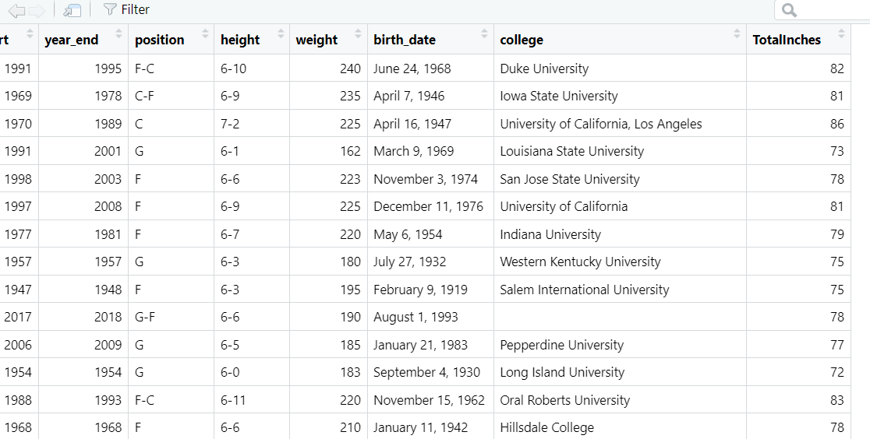
1.BBALL STUDY
We previously used a dataset called PlayerBBall.csv which contained information about NBA basketball players. To finish that assignment, you had to manipulate the height column. Review the code you used to do that and see if you can’t make more efficient code using regular expressions and / or the string functions from this Unit.
Use regular expressions to use the height column to create a TotalInches column that has the total height in inches and is recorded as a numeric variable.
Use this variable to make a chart that contains histograms of heights for every position (color coded).

Slide 18
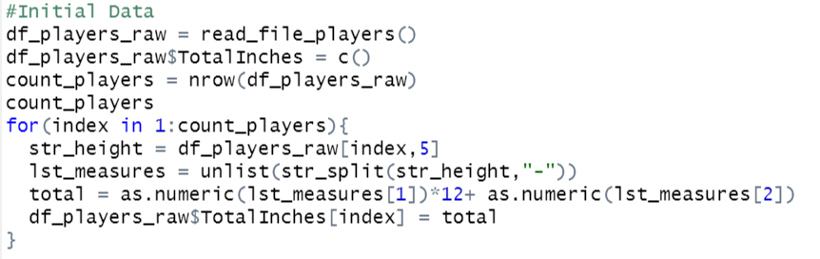
1.BBALL STUDY
Comments
It was much easier to use regular expressions and the functions the package stringr provides
As you can see in the picture, we used str_split to divide the feet from the inches and make the calculation
We also could use another regex and str_replace to make sure we didn’t have any strange character [^[:alnum:] ]

Slide 19
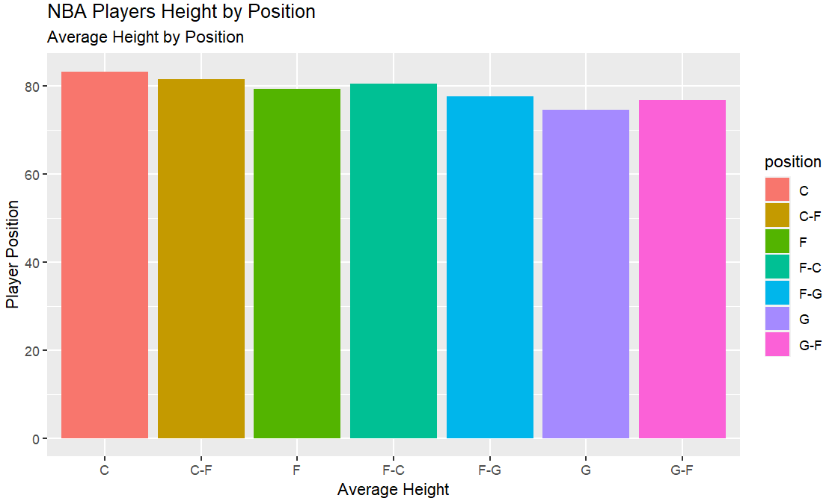
1.BBALL STUDY

Slide 20
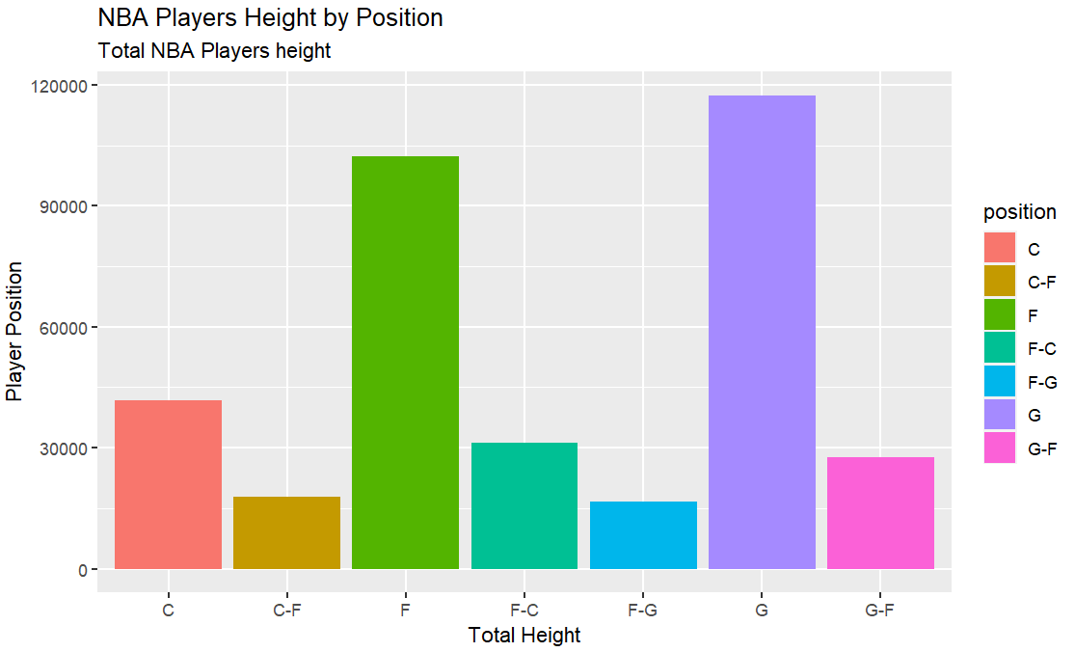
1.BBALL STUDY

Slide 21
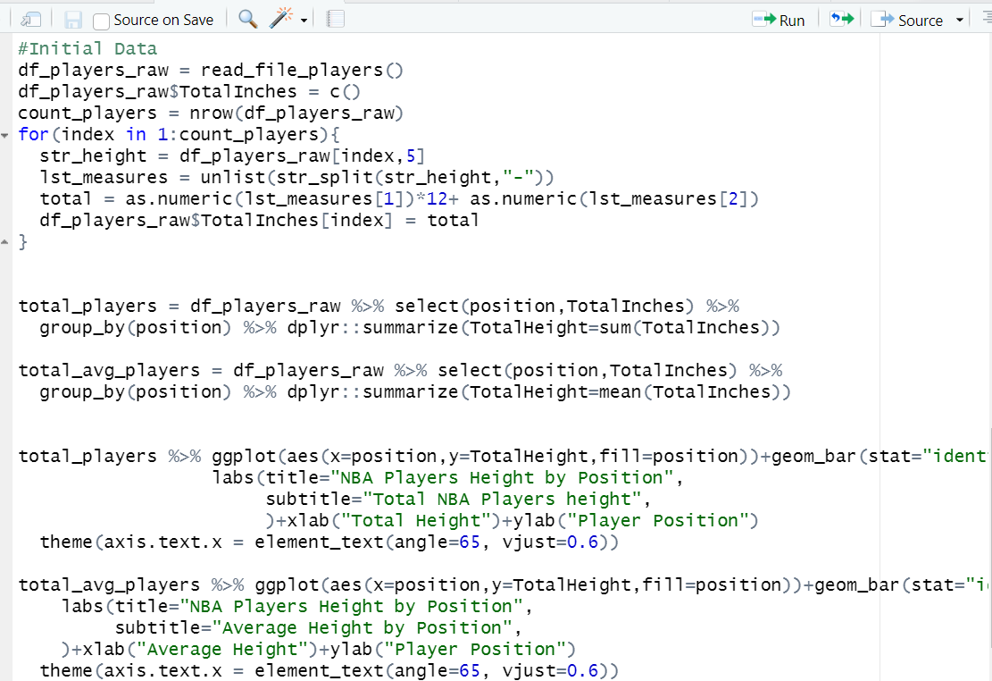
1.BBALL STUDY
Comments
Creation of the new column(Total Inches_
Height Avg and Total calculation
Plotting data

Slide 22
Part 2 (2-3 hours)

Slide 23
FIFA STUDY
We previously used a dataset called FIFA Players.csv which contained information about Soccer players.
Use the string functions and regular expressions to assess a relationship between height and weight among soccer players. To do this you will need to manipulate the height and weight columns into columns that have numeric values of the height and weight. Tell your story using 2 – 4 PPT Slides.
Next, assess this relationship between just the LB and LM positions. (1 slide should do it.)

Slide 24
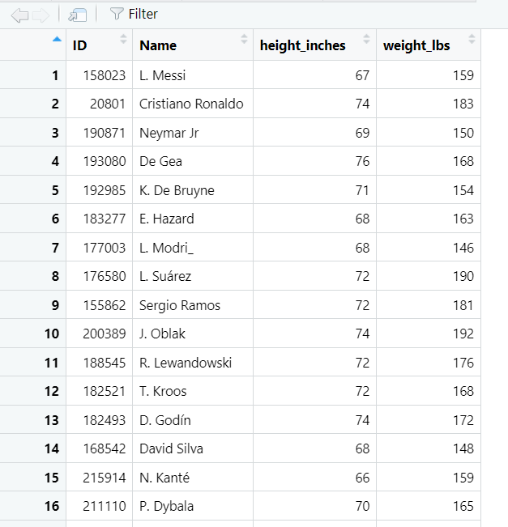
2.FIFA STUDY
We previously used a dataset called FIFA Players.csv which contained information about Soccer players.
Use the string functions and regular expressions to assess a relationship between height and weight among soccer players. To do this you will need to manipulate the height and weight columns into columns that have numeric values of the height and weight. Tell your story using 2 – 4 PPT Slides.

Slide 25
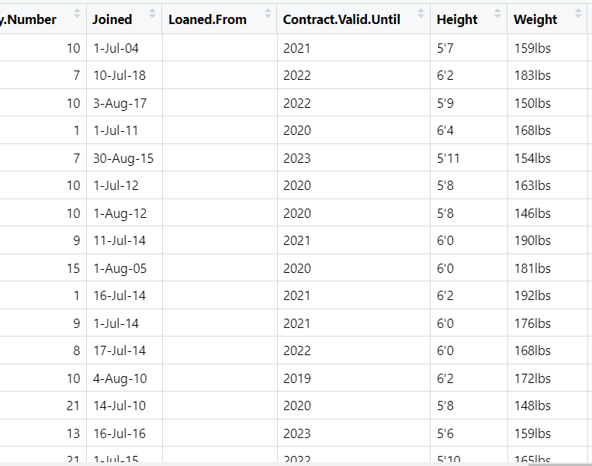
2.FIFA STUDY
Comments
In the image we can see the format of the variable weight and height
Approach for Height→use STR_SPLIT and ‘ as a separator
Approach for Weight→use STR_REPLACE and space for all character different than a digit

Slide 26
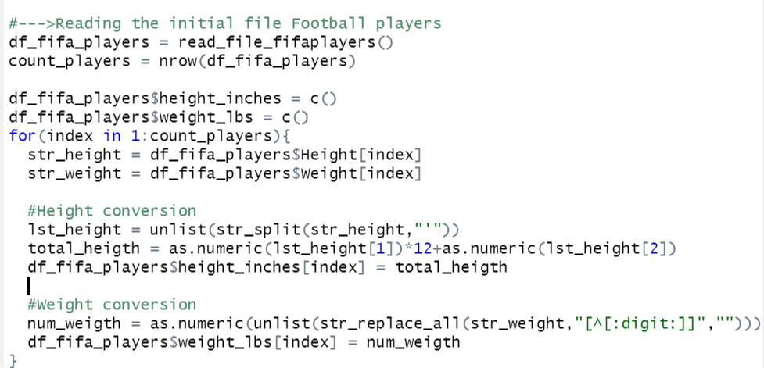
2.FIFA STUDY
Comments
We read the FifaPlayersFile.csv
As you can see in the picture, we used str_split to divide the feet from the inches and make the calculation
We also could use another regex and str_replace to make sure we didn’t have any strange character [^[:alnum:] ]
We use the regex [^[:digit:]] in order to remove all characters different than a number

Slide 27
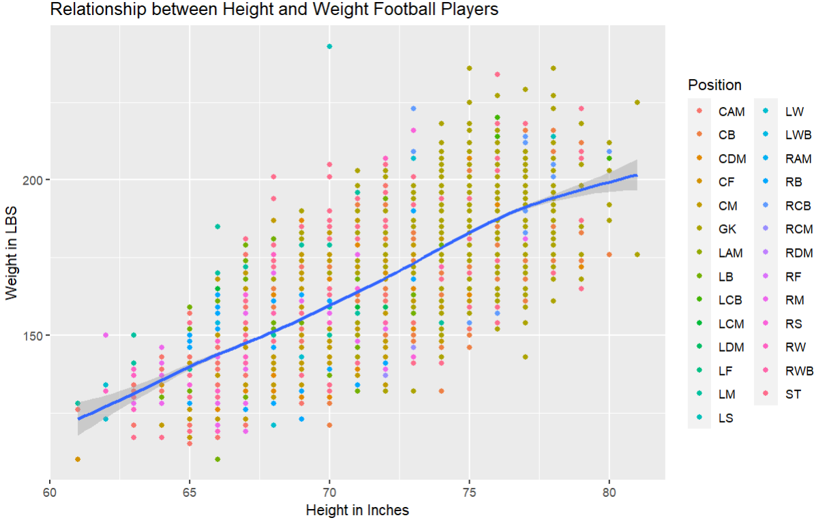
2.FIFA STUDY
Comments
Plotting the data
Scatterplot

Slide 28
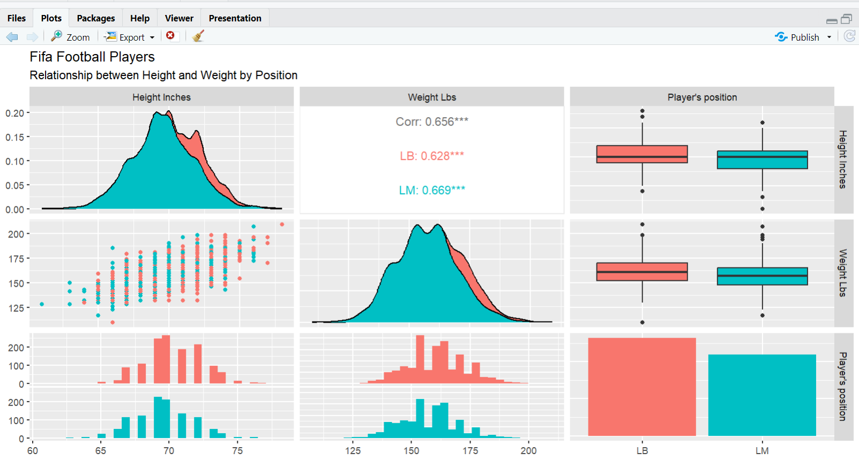
2.FIFA STUDY
Next, assess this relationship between just the LB and LM positions. (1 slide should do it.)
Comments
There’s a positive relationship between Height and Weight
According to the correlation coefficient and the plot, the relationship between both variables is more stong when it comes to LM players

Slide 29
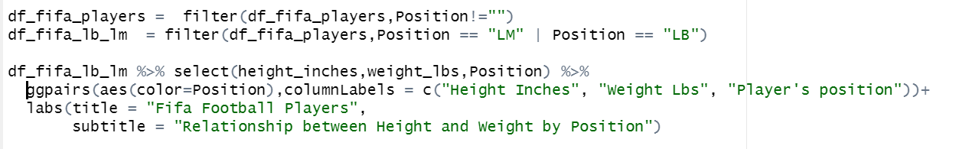
2.FIFA STUDY
Next, assess this relationship between just the LB and LM positions. (1 slide should do it.)
Comments
We filter the data to select only LM and LB player’s position
We plot using GGPAIRS

Slide 30
3.BABY NAMES
Backstory: Your client is expecting a baby soon. However, he is not sure what to name the child. Being out of the loop, he hires you to help him figure out popular names. He provides for you raw data in order to help you make a decision.

Slide 31
Baby Names: Question 1
Data Munging (30 points): Utilize yob2016.txt for this question. This file is a series of popular children’s names born in the year 2016 in the United States. It consists of three columns with a first name, a gender, and the amount of children given that name. However, the data is raw and will need cleaning to make it tidy and usable.
First, import the .txt file into R so you can process it. Keep in mind this is not a CSV file. You might have to open the file to see what you’re dealing with. Assign the resulting data frame to an object, df, that consists of three columns with human-readable column names for each.
Display the summary and structure of df
Your client tells you that there is a problem with the raw file. One name was entered twice and misspelled. The client cannot remember which name it is; there are thousands he saw! But he did mention he accidentally put three y’s at the end of the name. Write an R command to figure out which name it is and display it.
Upon finding the misspelled name, please remove this particular observation, as the client says it’s redundant. Save the remaining dataset as an object: y2016

Slide 32
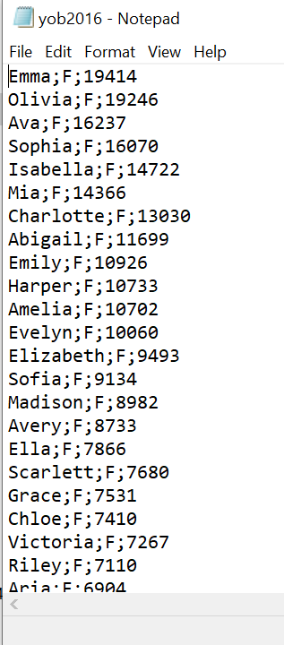
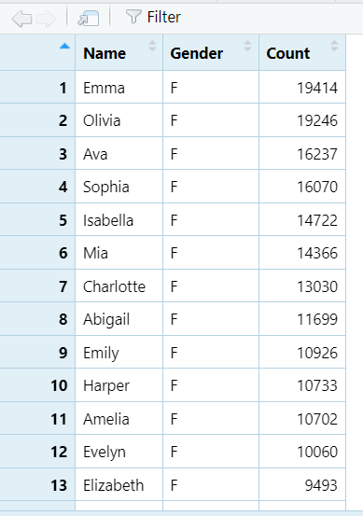
3.Baby Names: Question 1
First, import the .txt file into R so you can process it. Keep in mind this is not a CSV file. You might have to open the file to see what you’re dealing with. Assign the resulting data frame to an object, df, that consists of three columns with human-readable column names for each.
Display the summary and structure of df

Slide 33
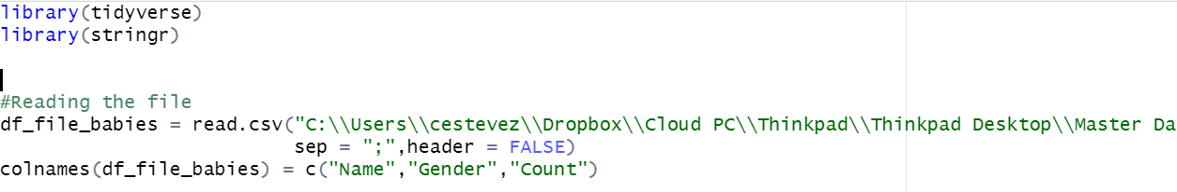
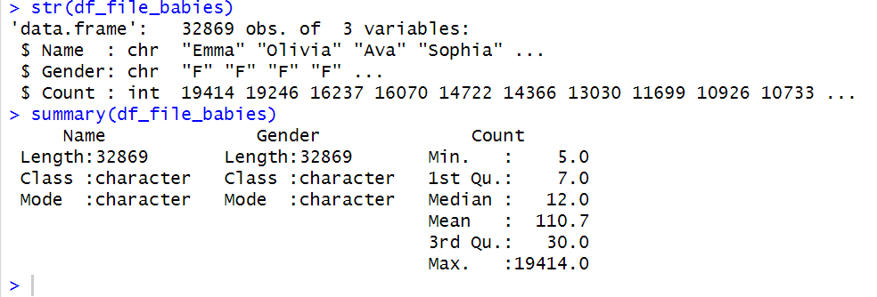
3.Baby Names: Question 1
Comments
Reading the file(Semicolon separator) and renaming columns
Summary and Structure of the data frame

Slide 34
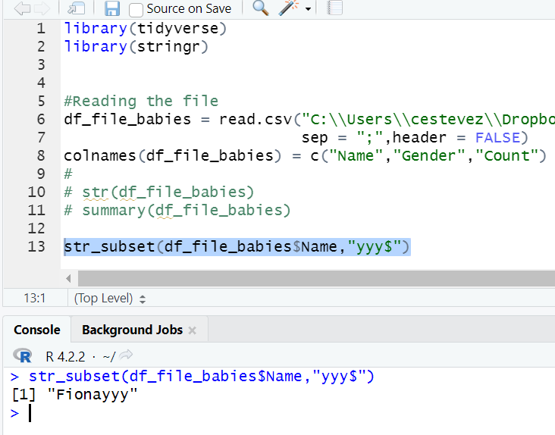
3.Baby Names: Question 1
Your client tells you that there is a problem with the raw file. One name was entered twice and misspelled. The client cannot remember which name it is; there are thousands he saw! But he did mention he accidentally put three y’s at the end of the name. Write an R command to figure out which name it is and display it.
Her name is Fiona
str_subset(df_file_babies$Name,"yyy$")

Slide 35
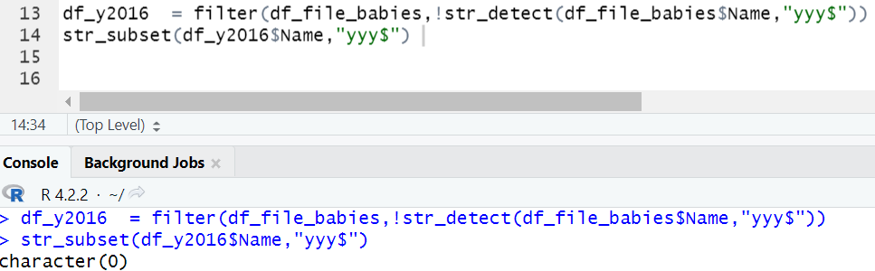
3.Baby Names: Question 1
b.Upon finding the misspelled name, please remove this particular observation, as the client says it’s redundant. Save the remaining dataset as an object: y2016
a. As you can see from the below image , the record was removed

Slide 36
Baby Names: Question 2
2. Data Merging (30 points): Utilize yob2015.txt for this question. This file is similar to yob2016, but contains names, gender, and total children given that name for the year 2015.
Like 1a, please import the .txt file into R. Look at the file before you do. You might have to change some options to import it properly. Again, please give the dataframe human-readable column names. Assign the dataframe to y2015.
Display the last ten rows in the dataframe. Describe something you find interesting about these 10 rows.
Merge y2016 and y2015 by your Name column; assign it to final. The client only cares about names that have data for both 2016 and 2015; there should be no NA values in either of your amount of children rows after merging.

Slide 37
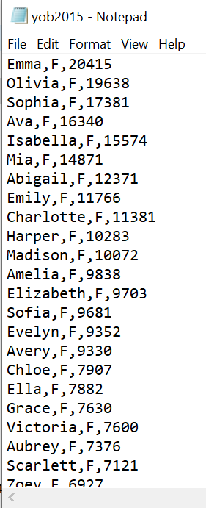
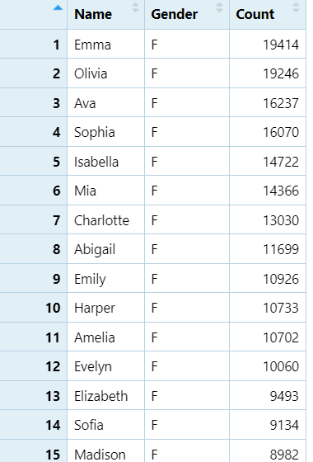
Baby Names: Question 2
2. Data Merging (30 points): Utilize yob2015.txt for this question. This file is similar to yob2016, but contains names, gender, and total children given that name for the year 2015.
Like 1a, please import the .txt file into R. Look at the file before you do. You might have to change some options to import it properly. Again, please give the dataframe human-readable column names. Assign the dataframe to y2015.
Display the last ten rows in the dataframe. Describe something you find interesting about these 10 rows.

Slide 38
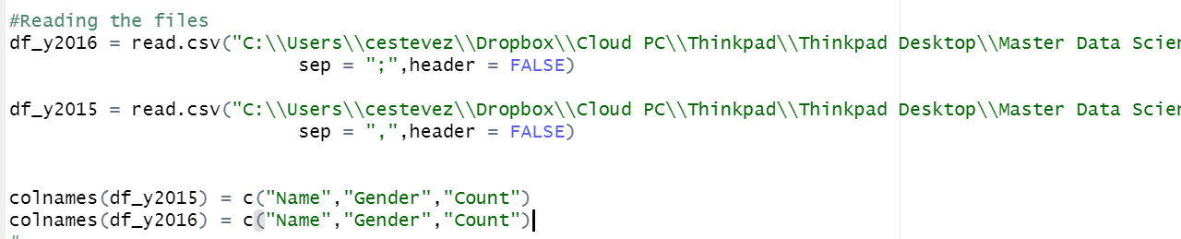
Baby Names: Question 2
a. Like 1a, please import the .txt file into R. Look at the file before you do. You might have to change some options to import it properly. Again, please give the dataframe human-readable column names. Assign the dataframe to y2015.
As you can see from the below source code, y2015 a convenrtional CSV without header, so we indicate that to the function
And rename the column names

Slide 39
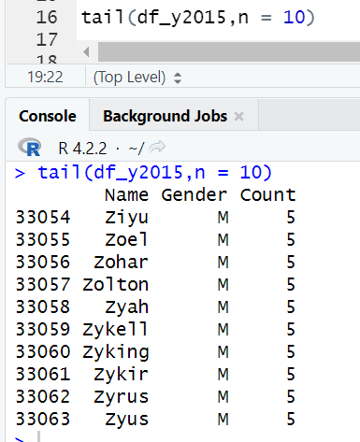
Baby Names: Question 2
b.Display the last ten rows in the dataframe. Describe something you find interesting about these 10 rows.

Slide 40
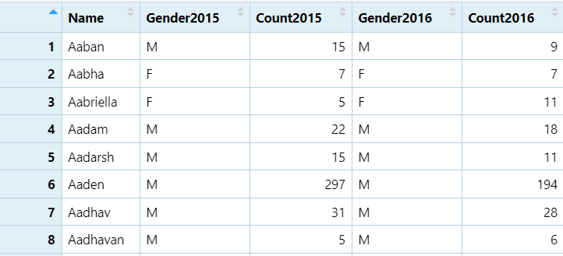
Baby Names: Question 2
c. Merge y2016 and y2015 by your Name column; assign it to final. The client only cares about names that have data for both 2016 and 2015; there should be no NA values in either of your amount of children rows after merging.
a.This is an Inner join relationship because it states that it is required to have entries common in both dataframe

Slide 41
Baby Names: Question 3
3. Data Summary (30 points): Utilize your data frame object final for this part.
Create a new column called “Total” in final that adds the amount of children in 2015 and 2016 together. In those two years combined, how many people were given popular names?
Sort the data by Total. What are the top 10 most popular names?
The client is expecting a girl! Omit boys and give the top 10 most popular girl’s names.
Write these top 10 girl names and their Totals to a CSV file. Leave out the other columns entirely.

Slide 42
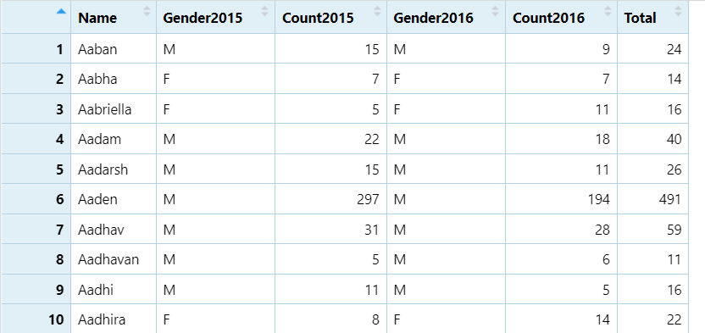
Baby Names: Question 3
3. Data Summary (30 points): Utilize your data frame object final for this part.
Create a new column called “Total” in final that adds the amount of children in 2015 and 2016 together. In those two years combined, how many people were given popular names?

Slide 43
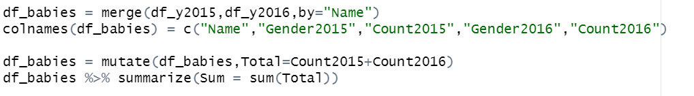
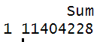
Baby Names: Question 3
3. Data Summary (30 points): Utilize your data frame object final for this part.
Create a new column called “Total” in final that adds the amount of children in 2015 and 2016 together. In those two years combined, how many people were given popular names?
In the below code we show how to add the total column
We show the number of people with popular names

Slide 44
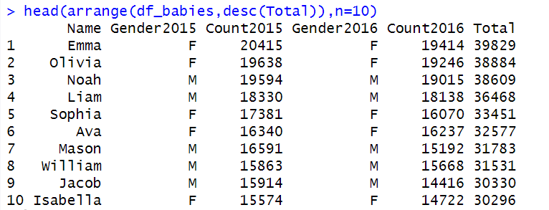
Baby Names: Question 3
3. Data Summary (30 points): Utilize your data frame object final for this part.
b.Sort the data by Total. What are the top 10 most popular names?
As you can see from the below image, we list the most 10 popular names

Slide 45
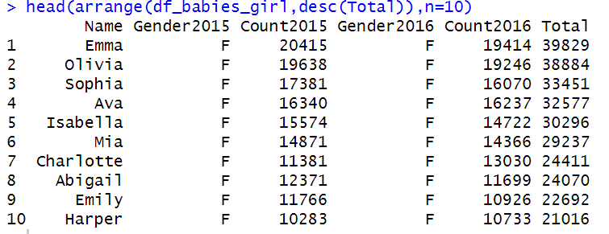
Baby Names: Question 3
c.client is expecting a girl! Omit boys and give the top 10 most popular girl’s names.
In the below image we present the top 10 most popular girls

Slide 46
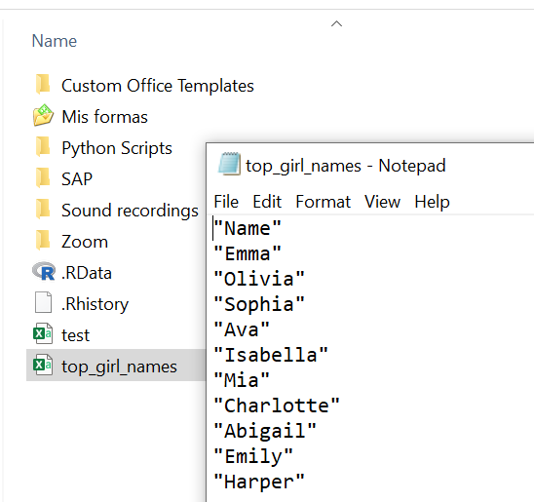
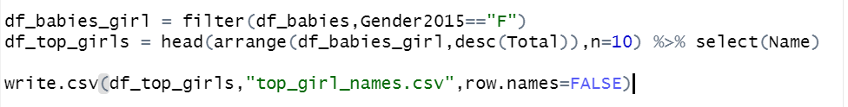
Baby Names: Question 3
d.Write these top 10 girl names and their Totals to a CSV file. Leave out the other columns entirely.

Slide 47
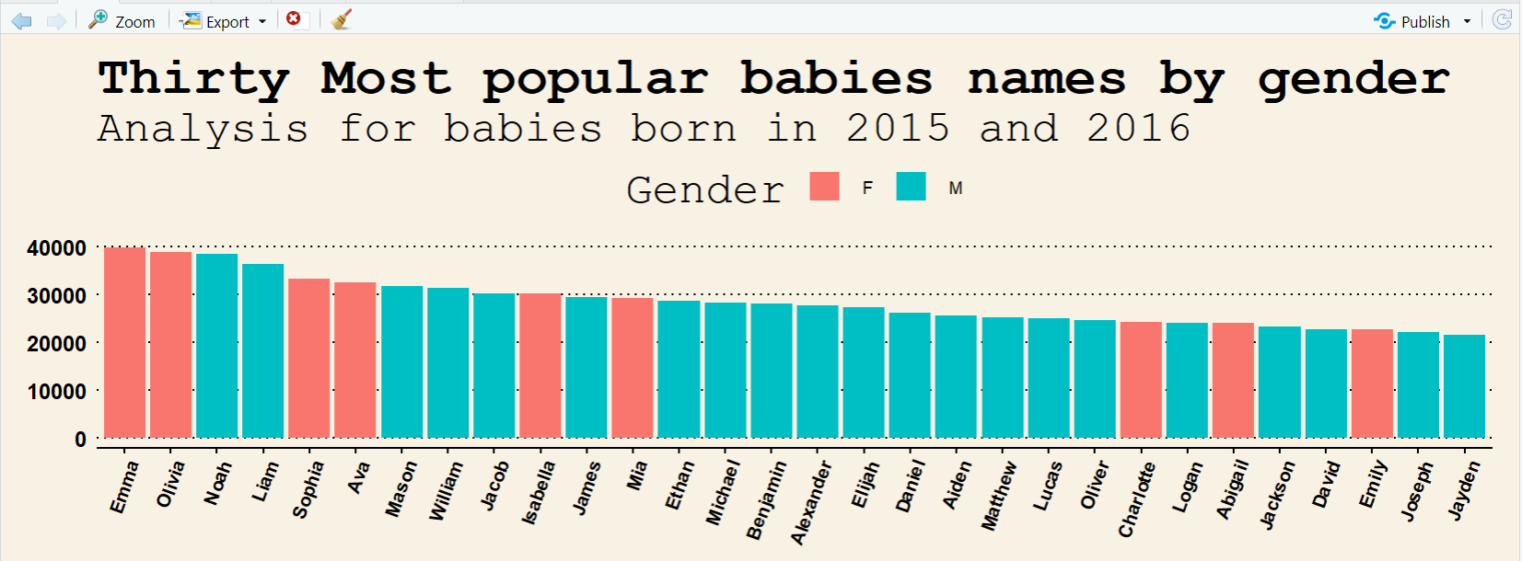
Baby Names: Question 4
4. Data Visualization: Create a well labeled, visually appealing and informative visualization summarizing some of the results of this study.

Slide 48
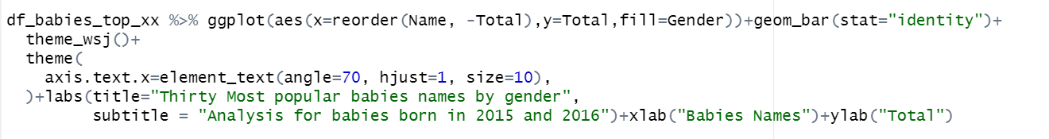
Baby Names: Question 4
4. Data Visualization: Create a well labeled, visually appealing and informative visualization summarizing some of the results of this study.
Comments
We use a geom_bar in order to plot the data of the most popular babies names in 2015 and 2016

Slide 49
Part 4 ($≤1 hour$)
Takeaways
and
questions!

Slide 50
Takeaways
Using REGEX is really helpful and useful when it comes to data cleaning and tidiness
We can also save a lot of time using REGEX and lines of code
Questions
I think everything was very clear. It was the largest lesson until this point, and I did not have time to do the bonus. I will certainly do it in the coming days
The only question that I have is , How often do you use lists? I mean, I know that list are very versatile in terms of storing different kind of objects very different from vectors where you can store just one object type. I am asking you because you haven’t used it too frequently. In Python , for example I use lists all the time.

